Slide 1
Designing the right application

Slide 2
Agenda
01
What is design?
02
Design thinking
03
Lean development
04
In practice…

Slide 3
What is Design?

Slide 4

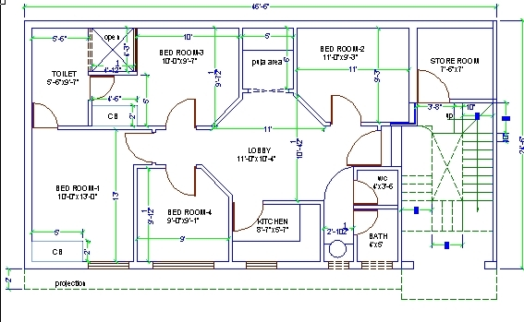
What is design?
CONCEPTS
By definition
“A plan or drawing produced to show the look and function or workings of a building, garment, or other object before it is made.”
01
THEN THIS IS DESIGN …
The style or pattern to be drawn on a garment.
02
… AND THIS IS DESIGN
A plan for the structure of a building floor.

Slide 5
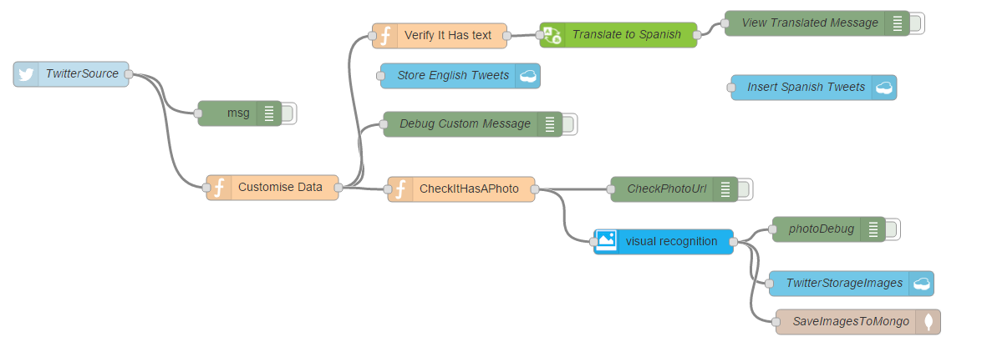
What is design?
CONCEPTS
Thinking further….
Perhaps if we take into consideration that design is “putting together drawings or patterns” we can resemble a similarity with creating complex applications.
03
THIS IS DESIGN TOO …
A schema about the application flow and the interactions of its components.

Slide 6
What is design?
CONCEPTS
Creating an application out of design
In reality, design starts long before any machine is ever required.
Translating a well defined design into an application, is in fact quite simple.
SO THEN, WHAT IS DESIGN?
Design is the approach you take to solving problems and understanding users and the insights you aquire in the process.

Slide 7
Design Thinking

Slide 8
Design thinking
PROBLEM SOLVING
A very simple problem..
Let’s investigate the process we use to solve problems…
!
WE HAVE A PROBLEM
WHAT IS THE COMMON APPROACH?
☺
LET’S ALL SIT IN A ROOM AND BRAINSTORM UNTIL WE FIND A SOLUTION
… PERHAPS, BUT THE REAL PROBLEM IS …
?
IS THIS REALLY A PROBLEM?

Slide 9
Design thinking
PROBLEM SOLVING
How to find if a problem is really a problem?
DESIGN THINKING
Design thinking is a framework for design which is user centric, and evolves around the user behaviour and feelings.
LET’S MAKE PEOPLE
WANT OUR APPLICATION
DESIGN THINKING
LET’S MAKE AN
APPLICATION PEOPLE WANT
BEFORE
NOW

Slide 10

Design thinking
DESIGN GOALS
What design should accomplish?
01
USER CENTERED
Design should satisfy a need or something the USER wants to do. Therefore the user cannot be left out. Assuming a solution without knowing the users may often become something unwanted.

Slide 11
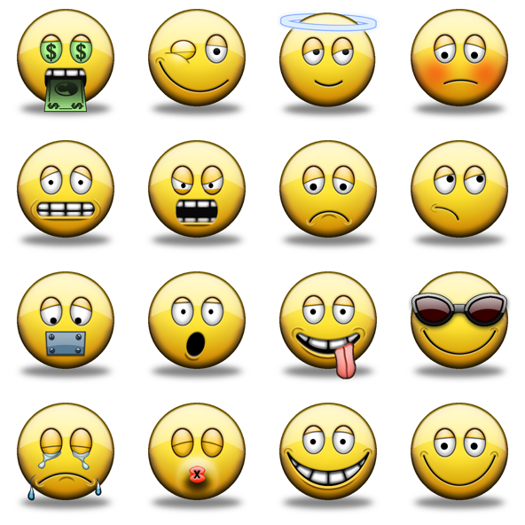
Design thinking
DESIGN GOALS
What design should accomplish?
02
USER SATISFACTION
People are different, culturally and behavior wise, therefore there is no one good solution for everyone. Everyone has different feelings. People should be HAPPY!

Slide 12
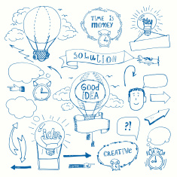
Design thinking
DESIGN GOALS
What design should accomplish?
03
FOSTER CREATIVITY
Solving problems is about great ideas, before thinking it is too difficult, you should try to envision it, if you can envision it, perhaps it is not so impossible to build it!

Slide 13
Design thinking
DESIGN GOALS
What design should accomplish?
FOCUS POINT
IN SUMMARY …
Build something the USER wants in order to make him HAPPY and build it with CREATIVITY!

Slide 14
Lean Development

Slide 15
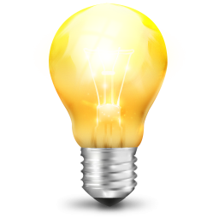
Lean development
PROCESS
Applying design thinking
I HAVE A GREAT IDEA?
?
HOW DO I KNOW IF IT IS A CORRECT ONE?
!
VALIDATE YOUR DESIGN THROUGH LEAN DEVELOPMENT

Slide 16
Lean development
CONCEPTS
What is lean development?
Lean Development is a methodology vastly used by tech start ups to validate their work quickly. It is based on continuous validation and small iterations.
DEFINITION
Lean manufacturing or lean production, often simply “lean” is a systematic method for the elimination of waste within the manufacturing system.
01
Validate your progress continuously.
02
Learn from your experience quickly.
03
Minimise waste.

Slide 17
Lean development
CONCEPTS
What is waste?
WHAT IS IT
Building something nobody wants, spending resources into doing this.
WHAT IS NOT
The time you have spent building something nobody wanted but you have learned from it.
CAN I AVOID IT?
The simplest thing you can do, is minimize waste. Lean Development aims to do this by minimize the time it takes to “learn” and making sure that only measurable outcomes are performed .

Slide 18
Lean development
CONCEPTS
Lean is based on three principles
BUILD
Start from an IDEA and build a Minimum Viable Product (MVP) from it.
MEASURE
Measure your MVP to obtain DATA.
LEARN
Learn from DATA to make new decisions (steer or pivot).
IDEA
build
MVP
measure
DATA
learn

Slide 19
Lean development
CONCEPTS
Lean process
In fact, lean development is an iterative process:
01
Each iteration should contain the feature that makes the MVP valuable.
02
By decreasing the amount of time per iteration, we can decrease waste.
03
Every iteration must be measurable.
IDEA
learn
build
DATA
MVP
measure
Notes:
LEAN MANUFACTURING OR LEAN PRODUCTION, OFTEN SIMPLY “LEAN”, IS A SYSTEMATIC METHOD FOR THE ELIMINATION OF WASTED WITHIN THE MANUFACTURING SYSTEM.

Slide 20
In practice …..

Slide 21
In practice …
EXAMPLE
Weather calls!
You had a fantastic idea for an automated weather forecast service over the phone…
You dial up and the service will automatically tell you the current weather.
?
What is the key element that tells you whether or not this idea will be successful?

Slide 22


In practice …
EXAMPLE
MVP: over the phone weather forecasts
Your MVP will probably only require that you have an incoming phone line and a person sitting at the desk with the weather forecast in front of her, reading it out to the user.
CUSTOMER
What’s the weather like tomorrow?
Tomorrow it will be sunny.
OPERATOR

Slide 23
In practice …
EXAMPLE
MVP: over the phone weather forecasts
After this initial proof of concept we can start making some useful observations:
01
WHERE IS THE AUTOMATION?
The automation is not a key characteristic of our idea and at present stage does not contribute to its success.
02
DO THE USER ACTUALLY CALL?
At this stage is more crucial to see whether the service is being used.

Slide 24
In practice …
EXAMPLE
MVP: over the phone weather forecasts
What can we learn so far?
01
IF PEOPLE DIALED THE SERVICE ….
… then you would have learned that the project si valid until now and iyou would move more confortably to implementing a new feature.
02
IF THEY DID NOT …
… perhaps it is time to go back to the drawing board. Maybe, they’re not interested after all.

Slide 25
In conclusion
LEARNINGS
What did we learn?
01
DESIGN
Design goes beyond “graphics”, it is the very heart of your project and how an idea becomes a product .
02
DESIGN THINKING
Design thinking is the process to understand real requirements based on a user centric framework.
03
LEAN DEVELOPMENT
Lean Development is a methodology that opts to create as little “waste” as possible in order to create the “right” product.

